Slide 1



The Road Back:
Teaching for Lost Learning
Dan Conley
Director of In-School AP
daniel.conley@coopacademies.co.uk

Slide 2
Session Outline
Why ISAPs? Why Reintegration?
The ‘How-To’ of Reintegration
Barriers, Challenges and Solutions

Slide 3
Session Outline
Why ISAPs? Why Reintegration?
The ‘How-To’ of Reintegration
Barriers, Challenges and Solutions

Slide 4
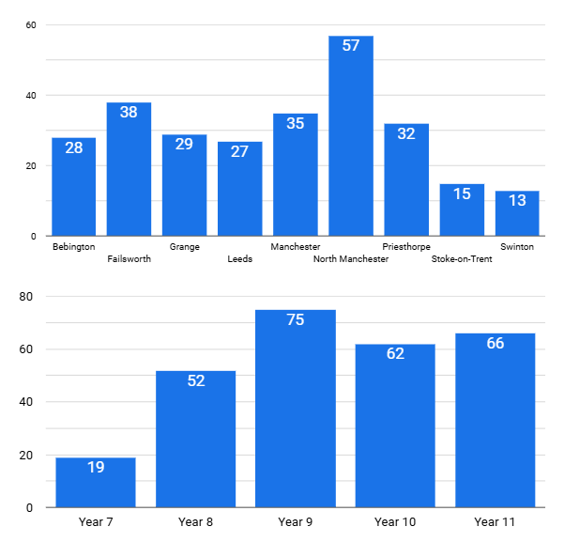
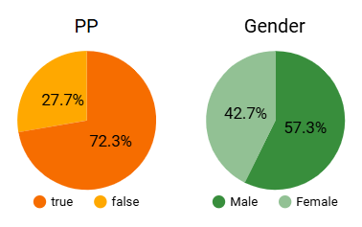
In-School AP
2024-2025
272 Students

Slide 5
Students: Who are ISAPs for?
Significant SEMH need and/or losing learning
Appropriate stage on graduated response
Rigorous assessment → bespoke provision
Secure relationships with pupils and families
↓
Reintegration back to Main School Lessons

Slide 6
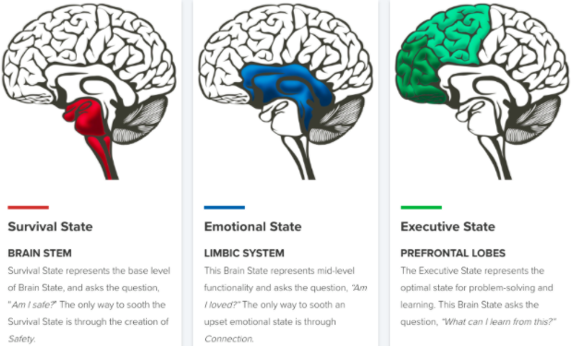
Neurosequential
Approach
Reason
Relate
Regulate

Slide 7
Impact: Reintegrated or ISAP Students
Attendance
Suspensions / Exclusions
SEMH Progress
Academic Progress
Reintegrations
GCSEs / Qualifications / CV
Post-16 Destinations

Slide 8
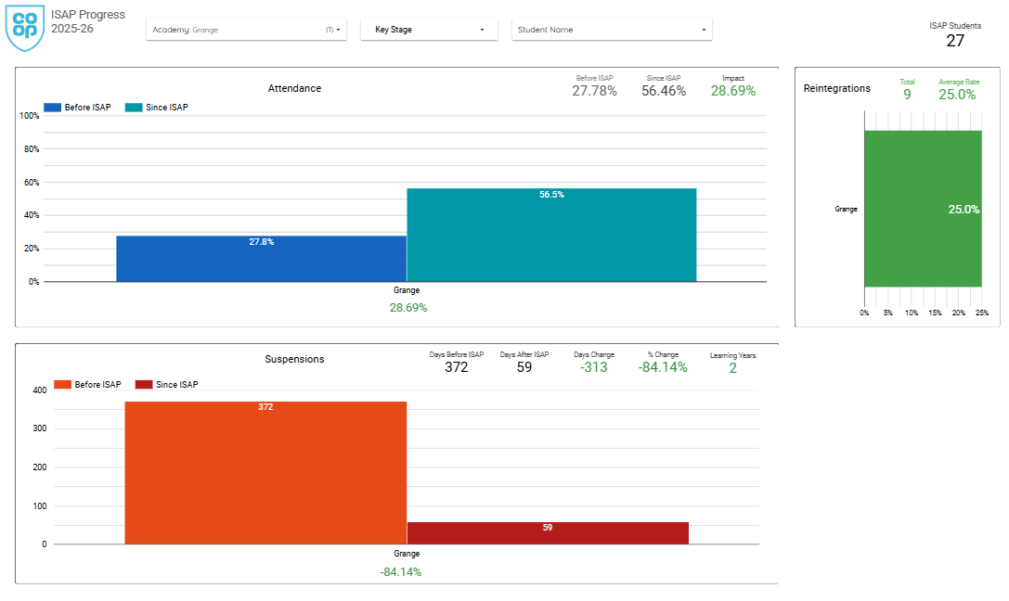
Bridge Headlines: 2025-2026
Students: 27
Attendance Impact: 28.69%
Reintegrations: 25.0%
Suspensions: -84.14%
Lost Learning: 2 Years!

Slide 9
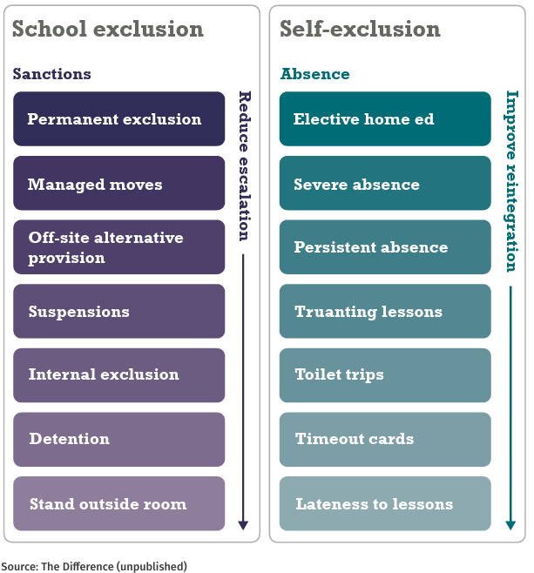
Reintegration takes many forms!
Source: Who’s Losing Learning Report, The Difference (2024)

Slide 10
Session Outline
Why ISAPs? Why Reintegration?
The ‘How-To’ of Reintegration
Barriers, Challenges and Solutions

Slide 11




Example: ISAP Reintegration
Inclusion Panel (SLT / SENCO / ISAP)
Parent / Student Meeting
Teachers Informed / Consulted
Phased / Supported return

Slide 12
Session Outline
Why ISAPs? Why Reintegration?
The ‘How-To’ of Reintegration
Barriers, Challenges and Solutions

Slide 13
Barriers, Challenges and Solutions
Think of 3 major barriers / challenges for the student
Then 3 barriers and challenges for the teacher
For each barrier, what solutions are there?

Slide 14
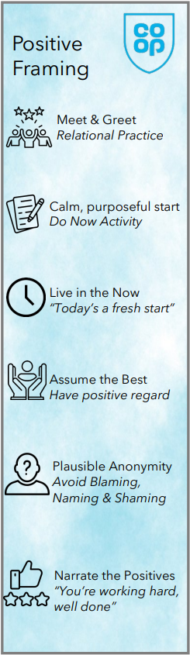
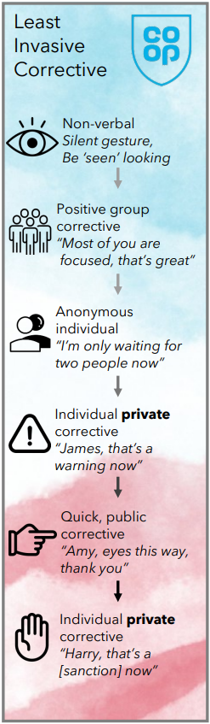
If nothing else…
This is my go-to guide for any busy teacher.
If you’re doing this for a reintegrating student, the rest is a bonus.

Slide 15
Regulational Solutions
Reason
Predictable routines
Countdown timers
Minimise noise
Paper clips & blu-tack!
Trusted adult check-in
Exit routes / routines
Zones of Regulation
Box breathing (4,4,4,4)
Relate
Regulate

Slide 16
Motivational Solutions
Reason
Meet & greet
Relational approach
Natural curiosity
Frequent Praise
Calm voice
Stand beside
↓
Relate
Regulate

Slide 17

Motivational Solutions
Reason
“Come up and see me, make me smile”
Relate
Regulate

Slide 18
Academic Solutions
Reason
Let them be a ‘normal’ student
Avoid ‘catch-up’ Narrative
Explain Curriculum Journey
Share Resources
Independent Learning Plan
Portfolio of Achievement
Exam Entry Flexibility
Results aren’t the only outcome
Unit Award Scheme Options
Relate
Regulate

Slide 19

The Great Success Story
Reason
Celebrate successes with parents - they’re often isolated, disengaged or without hope.
Each student presents an opportunity for you to share in a great success story, one that could have lifelong ‘sliding doors’ implications.
Relate
Regulate

Slide 20
Session Outline
Why ISAPs? Why Reintegration?
The ‘How-To’ of Reintegration
Barriers, Challenges and Solutions

Slide 21
The Road Back:
Teaching for Lost Learning
Dan Conley
Director of In-School AP
daniel.conley@coopacademies.co.uk

Slide 22
Site of uniquely human capabilities
Logical reasoning, planning, inhibiting
Fully matures at 25 years
Frontal Cortex
Seat of our emotion
Relational connection / attachment
Matures at 10-13 years
Limbic System
Life support centre
Pulse, breathing, blood pressure
Mature by birth
Brain Stem

Slide 23
Meet your body…

Slide 24
Take yourself back to a major and heated conflict you had with someone. Try to visualise the place you were in and the events as clearly as possible. Try to inhabit your body and experience it again.

Slide 25
Agree or Disagree?
I was distracted for over an hour afterwards
It took at least an hour for my body to relax
Later, I thought of things I wished I’d said

Slide 26
Brain meets body…

Slide 27

Our ‘Lookout System’
Brain pathways that constantly monitor our environments and other people, looking for threats and danger
Lookout
System
Source: Porges (2011)

Slide 28
‘Threat / Stress’ Response
Reaction to threat / danger
Fight, flight, or freeze
Higher reasoning shuts down
Heart / breathing rate ↑
Lookout
System
Source: Selye (1956)

Slide 29
‘Social Engagement’ Response
Promotes socially appropriate behaviour, clear thinking, learning and problem-solving
Lookout
System
Source: Siegel and Bryson (2012)

Slide 30
Your Argument
What was the threat?
Fight, flight, or freeze
Higher reasoning shuts down
(Things you wished you’d said?)
Heart / breathing rate ↑
Lookout
System

Slide 31
Early Trauma
Major / chronic activation
‘Primes’ the lookout system
Becomes over-sensitised
Hypervigilance
Behavioural dysregulation
Lookout
System

Slide 32
Video
The Neurosequential Model

Slide 33
Neurosequential
Approach
What went wrong?
Assertive body language
Blocking exits / cornering
Disinterest / dismissive
Verbal threats / challenges
Lookout
System
An Incident in School: BBC3

